Slide 1
GE IV: ELEMENTS OF ANALYSIS
B.A(HONS.) ECONOMICS
SEMESTER IV
SUPPLEMENTARY STUDY MATERIAL
UNIT III: POWER SERIES

Slide 2
APPLICATIONS OF GEOMETRIC SERIES FOR FINDING POWER SERIES USING
DIFFERENTIATION AND INTEGRATION

Slide 3
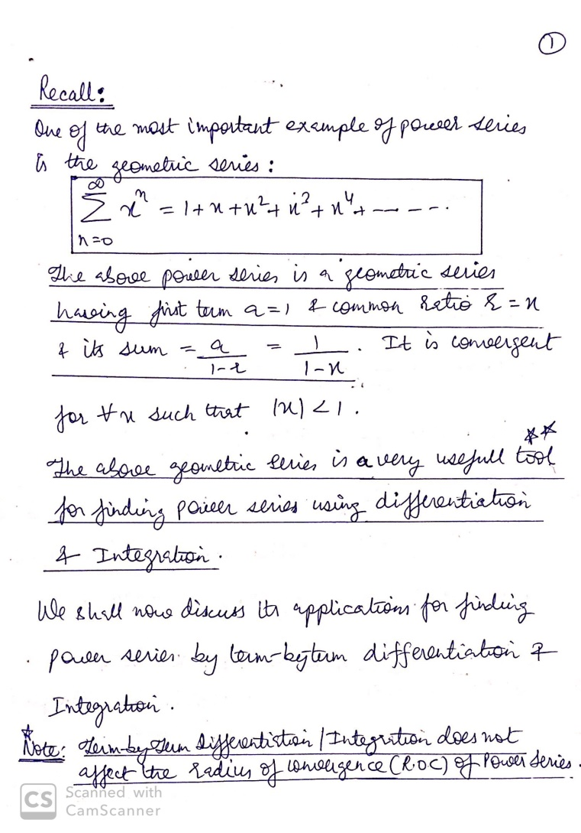

Slide 4
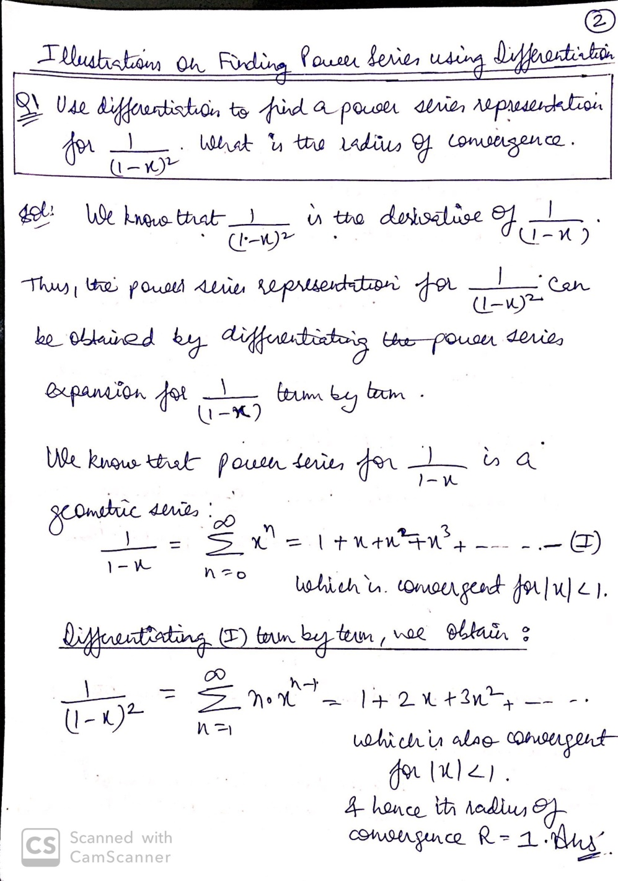

Slide 5
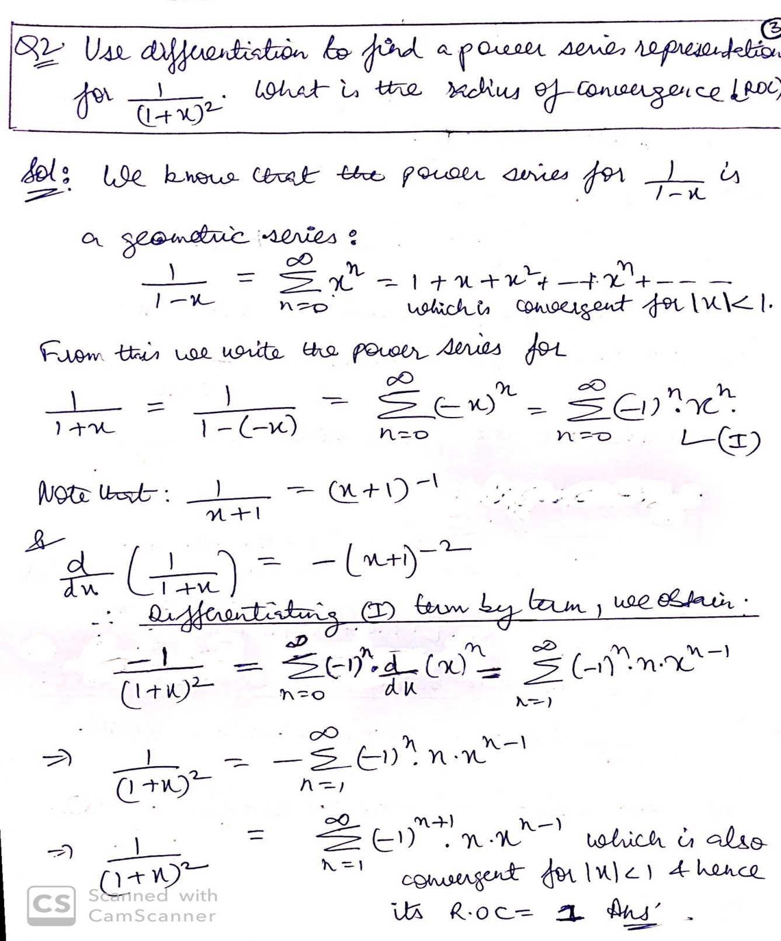

Slide 6
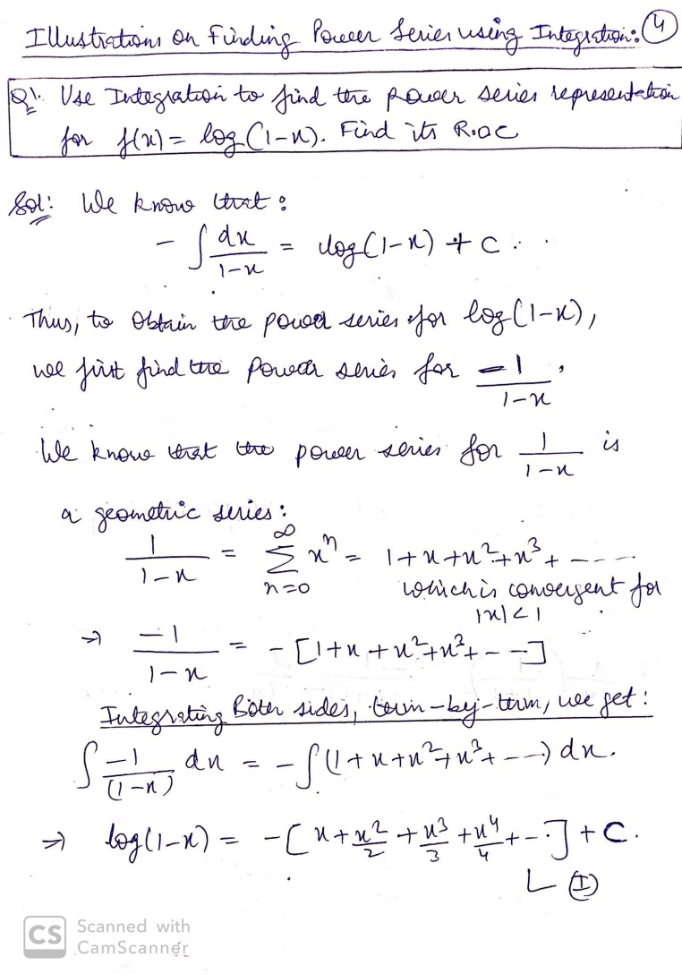

Slide 7
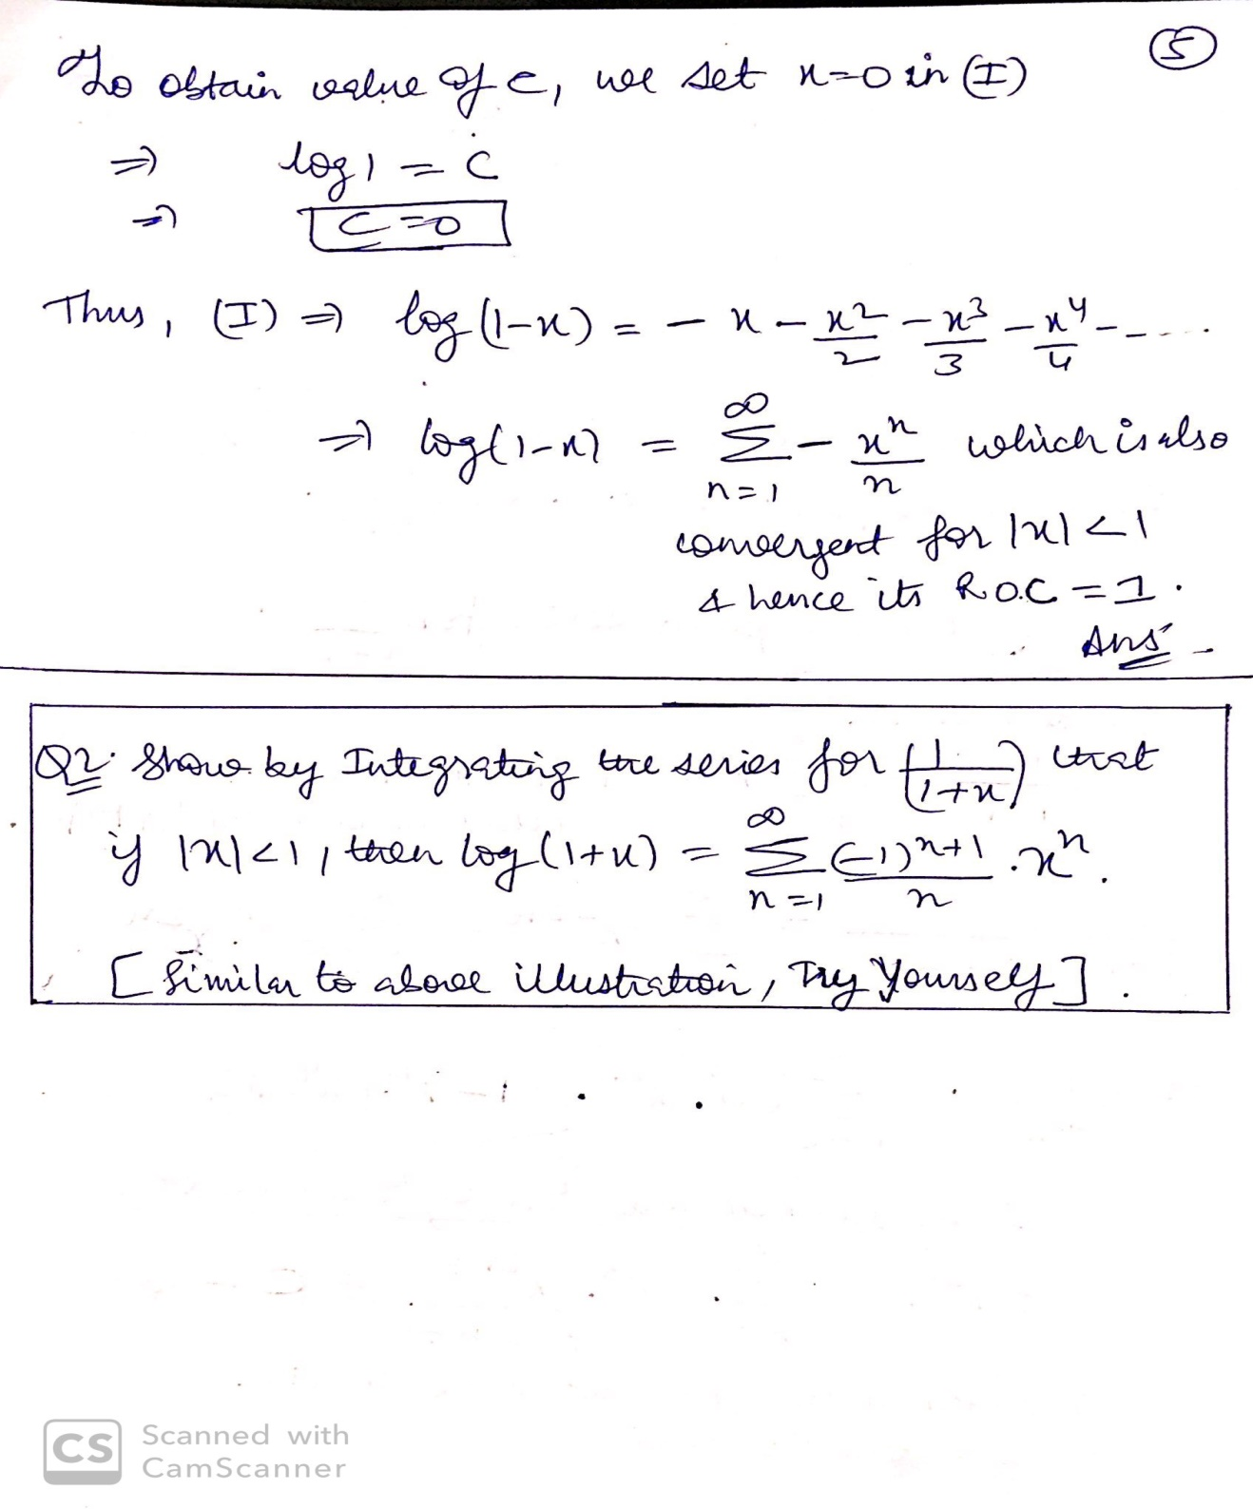

Slide 8
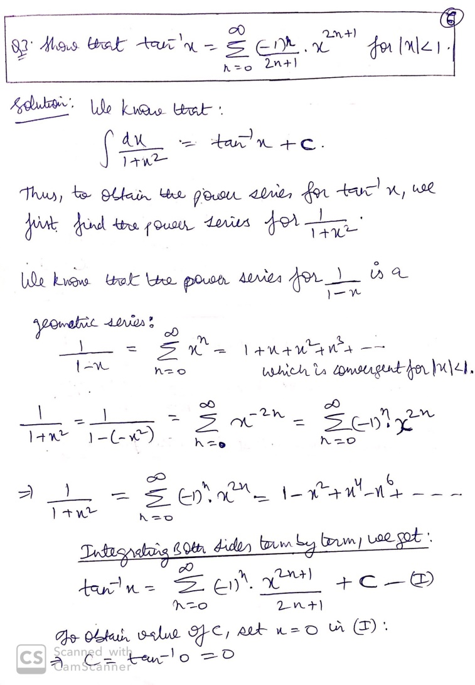

Slide 9
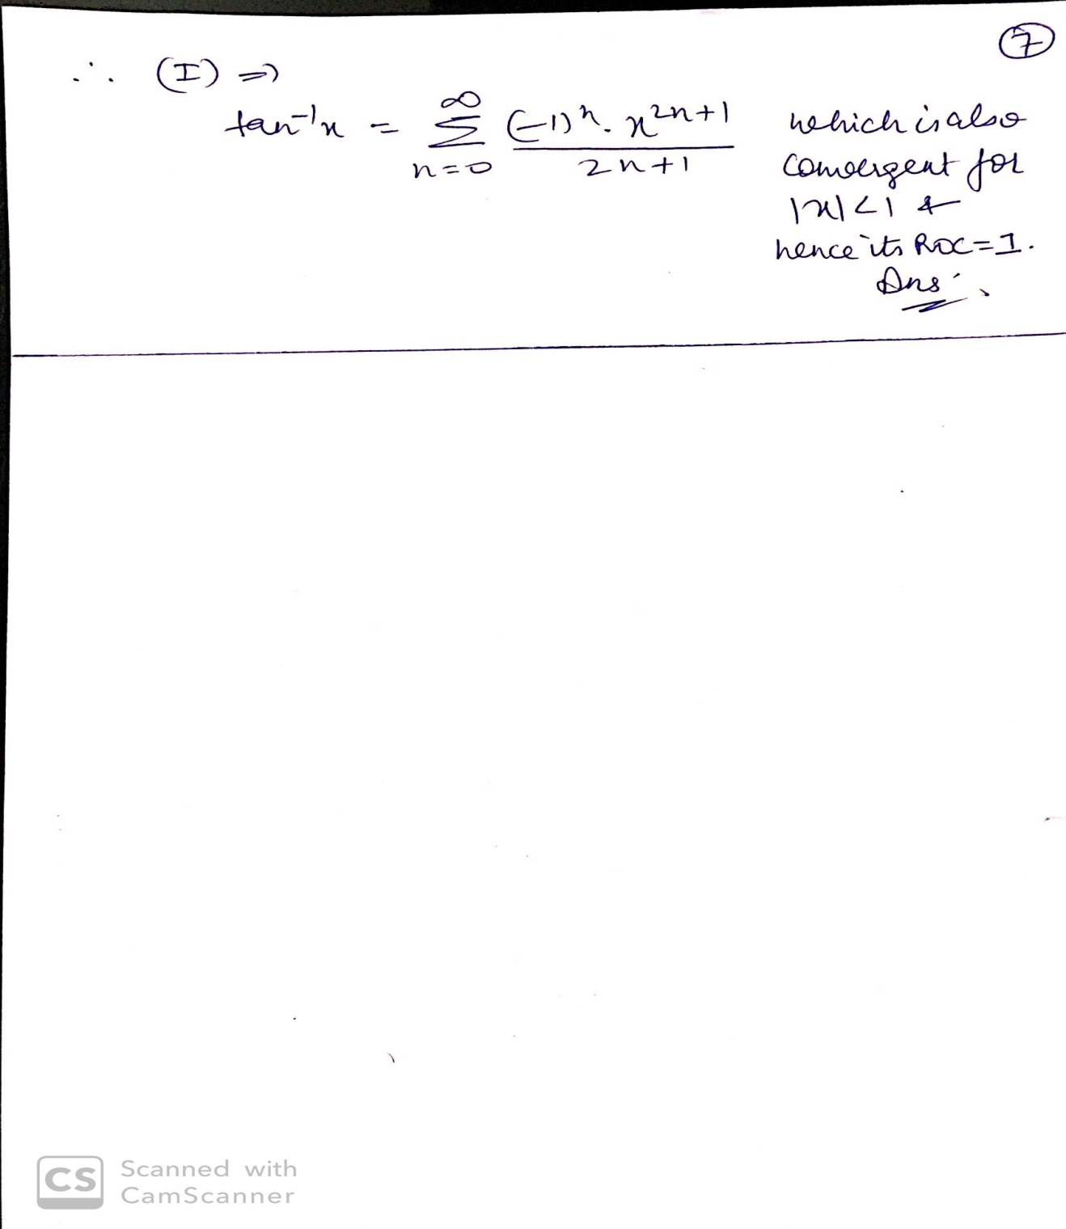

Slide 10
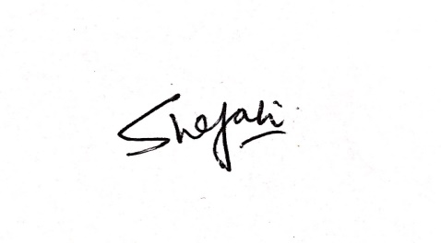
FOR ANY ADDITIONAL INFORMATION OR DISCUSSION, STUDENTS MAY FEEL FREE TO CONTACT THE UNDERSIGNED.
DR. SHEFALI KAPOOR
ASSISTANT PROFESSOR
DEPARTMENT OF MATHEMATICS
SRCC

